Slide 1
Chapter 3:
Marketing on the Web
Electronic Commerce, Sixth Edition

Slide 2
Objectives
In this chapter, you will learn about:
When to use product-based and customer-based marketing strategies
Communicating with different market segments
Customer relationship intensity and the customer relationship life cycle
Using advertising on the Web
Electronic Commerce, Sixth Edition

Slide 3
Objectives (continued)
E-mail marketing
Technology-enabled customer relationship management
Creating and maintaining brands on the Web
Search engine positioning and domain name selection
Electronic Commerce, Sixth Edition

Slide 4
Web Marketing Strategies
Four Ps of marketing
  Product
    Physical item or service that the company is selling
  Price
    Amount customer pays for the product
  Promotion
    Any means of spreading the word about the product
  Place
    Need to have products or services available in different locations
Electronic Commerce, Sixth Edition

Slide 5
Product-Based Marketing Strategies
When creating a marketing strategy
  Managers must consider both the nature of their products and the nature of their potential customers
Most office supply stores on the Web
  Believe customers organize their needs into product categories
Electronic Commerce, Sixth Edition

Slide 6
Customer-Based Marketing Strategies
Good first step in building a customer-based marketing strategy
  Identify groups of customers who share common characteristics
B2B sellers
  More aware of the need to customize product and service offerings to match their customers’ needs
Electronic Commerce, Sixth Edition

Slide 7
Communicating with Different Market Segments
Identify groups of potential customers
  The first step in selling to those customers
Media selection
  Can be critical for an online firm
Challenge for online businesses
  Convince customers to trust them
Electronic Commerce, Sixth Edition

Slide 8
Trust and Media Choice
The Web is an intermediate step between mass media and personal contact
Cost of mass media advertising can be spread over its audience
Companies can use the Web to capture some of the benefits of personal contact, yet avoid some of the costs inherent in that approach
Electronic Commerce, Sixth Edition

Slide 9
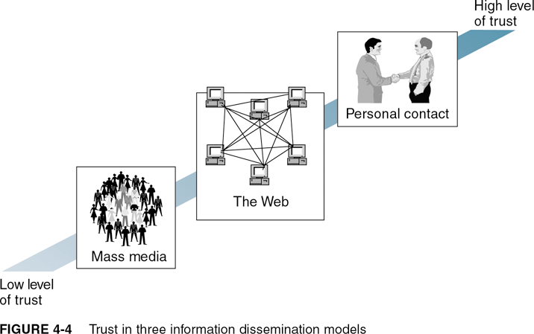
Trust in Three Information Dissemination Models
Electronic Commerce, Sixth Edition

Slide 10
Market Segmentation
Targeting specific portions of the market with advertising messages
Segments
  Usually defined in terms of demographic characteristics
Micromarketing
  Targeting very small market segments
Electronic Commerce, Sixth Edition

Slide 11
Market Segmentation (continued)
Geographic segmentation
  Creating different combinations of marketing efforts for each geographical group of customers
Demographic segmentation
  Uses age, gender, family size, income, education, religion, or ethnicity to group customers
Electronic Commerce, Sixth Edition

Slide 12
Market Segmentation (continued)
Psychographic segmentation
  Groups customers by variables such as social class, personality, or their approach to life
Electronic Commerce, Sixth Edition

Slide 13
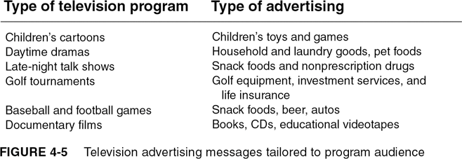
Television Advertising Messages Tailored to Program Audience
Electronic Commerce, Sixth Edition

Slide 14
Beyond Market Segmentation: Customer Behavior and Relationship Intensity
Behavioral segmentation
  Creation of separate experiences for customers based on their behavior
Occasion segmentation
  When behavioral segmentation is based on things that happen at a specific time
Usage-based market segmentation
  Customizing visitor experiences to match the site usage behavior patterns of each visitor
Electronic Commerce, Sixth Edition

Slide 15
Behavior-Based Categories
Simplifiers
  Like convenience
Surfers
  Use the Web to find information and explore new ideas
Bargainers
  Are in search of a good deal
Connectors
  Use the Web to stay in touch with other people
Routiners
  Return to the same sites over and over again
Electronic Commerce, Sixth Edition

Slide 16
Customer Relationship Intensity and Life-Cycle Segmentation
One goal of marketing is to create strong relationships between a company and its customers
Good customer experiences can help create intense feeling of loyalty
Touchpoints
  Online and offline customer contact points
Touchpoint consistency
  Goal of providing similar levels and quality of service at all touchpoints
Electronic Commerce, Sixth Edition

Slide 17
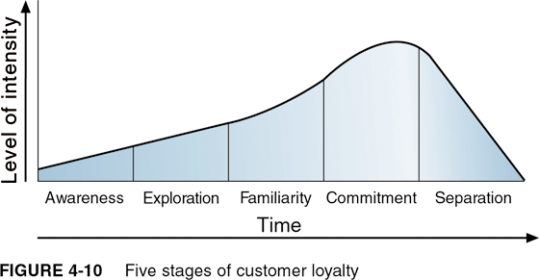
Five Stages of Customer Loyalty
Electronic Commerce, Sixth Edition

Slide 18
Acquisition, Conversion, and Retention of Customers
Acquisition cost
  Money a site spends to draw one visitor to the site
Conversion
  Converting a first-time visitor into a customer
Conversion cost
  Cost of inducing one visitor to make a purchase, sign up for a subscription, or register
Retained customers
  Customers who return to the site one or more times after making their first purchases
Electronic Commerce, Sixth Edition

Slide 19
Customer Acquisition, Conversion, and Retention: The Funnel Model
Marketing managers need to have a good sense of how their companies acquire and retain customers
Funnel model
  Used as a conceptual tool to understand the overall nature of a marketing strategy
  Very similar to the customer life-cycle model
Electronic Commerce, Sixth Edition

Slide 20
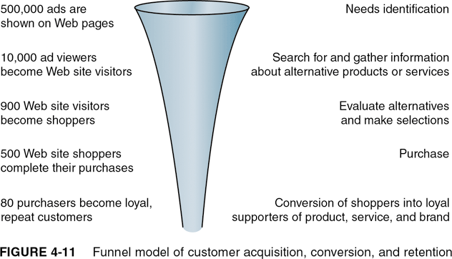
Funnel Model of Customer Acquisition, Conversion, and Retention
Electronic Commerce, Sixth Edition

Slide 21
Advertising on the Web
Banner ad
  Small rectangular object on a Web page
Interactive marketing unit (IMU) ad formats
  Standard banner sizes that most Web sites have voluntarily agreed to use
Banner exchange network
  Coordinates ad sharing
Banner advertising network
  Acts as a broker between advertisers and Web sites that carry ads
Electronic Commerce, Sixth Edition

Slide 22
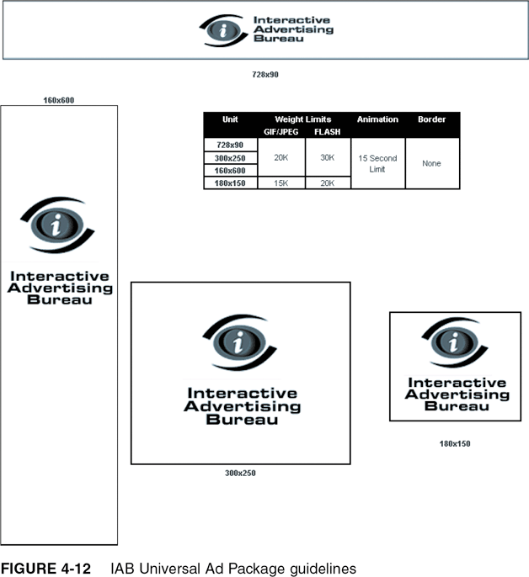
IAB Universal Ad Package Guidelines
Electronic Commerce, Sixth Edition

Slide 23
Advertising on the Web (continued)
Cost per thousand (CPM)
  Pricing metric used when a company purchases mass media advertising
Trial visit
  First time a visitor loads a Web site page
Page view
  Each page loaded by a visitor
Impression
  Each time the banner ad loads
Electronic Commerce, Sixth Edition

Slide 24
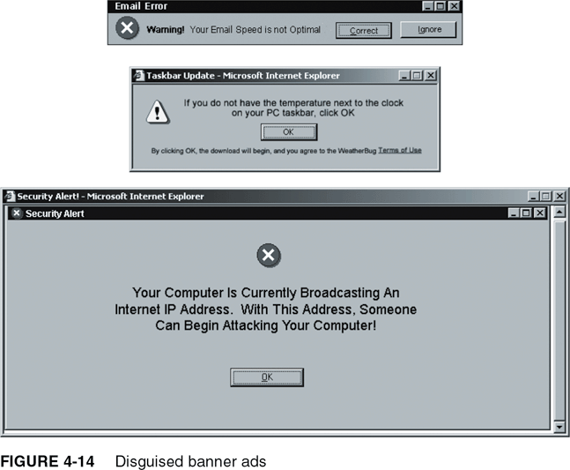
Disguised Banner Ads
Electronic Commerce, Sixth Edition

Slide 25
Other Web Ad Formats
Pop-up ad
  Appears in its own window when the user opens or closes a Web page
Ad-blocking software
  Prevents banner ads and pop-up ads from loading
Interstitial ad
  When a user clicks a link to load a page, the interstitial ad opens in its own browser window
Electronic Commerce, Sixth Edition

Slide 26
Site Sponsorships
Give advertisers a chance to promote products, services, or brands in a more subtle way
Helps build brand images and develop reputation rather than generate immediate sales
Electronic Commerce, Sixth Edition

Slide 27
E-Mail Marketing
Sending one e-mail message to a customer
  Can cost less than one cent if the company already has the customer’s e-mail address
Conversion rate
  The percentage of recipients who respond to an ad or promotion
Opt-in e-mail
  Practice of sending e-mail messages to people who request information on a particular topic
Electronic Commerce, Sixth Edition

Slide 28
Technology-Enabled Customer Relationship Management
Clickstream
  Information that a Web site can gather about its visitors
Technology-enabled relationship management
  Firm obtains detailed information about a customer’s behavior, buying patterns, etc. and uses it to set prices and negotiate terms
Electronic Commerce, Sixth Edition

Slide 29
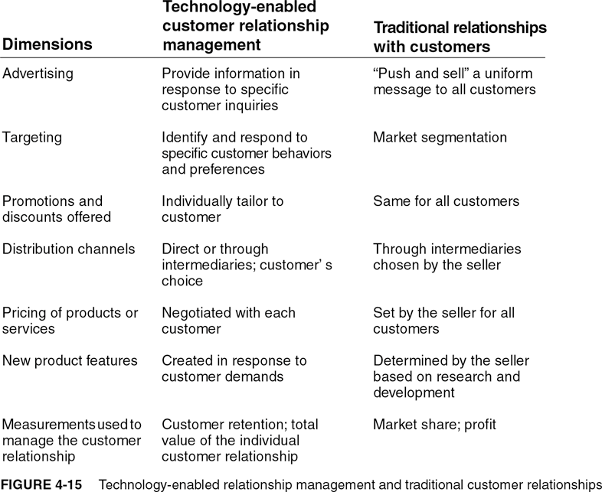
Technology-Enabled Relationship Management and Traditional Customer Relationships
Electronic Commerce, Sixth Edition

Slide 30
Creating and Maintaining Brands on the Web
Elements of Branding
  Differentiation
    Company must clearly distinguish its product from all others
  Relevance
    Degree to which product offers utility to a potential customer
  Perceived value
    Key element in creating a brand that has value
Electronic Commerce, Sixth Edition

Slide 31
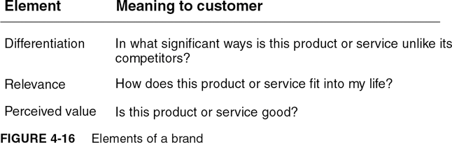
Elements of a Brand
Electronic Commerce, Sixth Edition

Slide 32
Emotional Branding vs. Rational Branding
Emotional appeals
  Difficult to convey on the Web
Rational branding
  Relies on the cognitive appeal of the specific help offered, not on a broad emotional appeal
Electronic Commerce, Sixth Edition

Slide 33
Affiliate Marketing Strategies
Affiliate marketing
  One firm’s Web site includes descriptions, reviews, ratings, or other information about a product that is linked to another firm’s site
Affiliate site
  Obtains the benefit of the selling site’s brand in exchange for the referral
Cause marketing
  Affiliate marketing program that benefits a charitable organization
Electronic Commerce, Sixth Edition

Slide 34
Viral Marketing Strategies
Relies on existing customers to tell other people about products or services they have enjoyed using
Example
  Blue Mountain Arts
    Electronic greeting card company
    Purchases very little advertising, but grew rapidly
Electronic Commerce, Sixth Edition

Slide 35
Search Engine Positioning and Domain Names
Search engine
  Web site that helps people find things on the Web
  Spider, crawler, or robot
    Program that automatically searches the Web
Index or database
  Storage element of a search engine
Search utility
  Uses terms provided to find Web pages that match
Electronic Commerce, Sixth Edition

Slide 36
Search Engine Positioning and Domain Names (continued)
Nielsen//NetRatings
  Frequently issues press releases that list most frequently visited Web sites
Search engine ranking
  Weighting factors used by search engines to decide which URLs appear first on searches
Electronic Commerce, Sixth Edition

Slide 37
Search Engine Positioning and Domain Names (continued)
Search engine positioning or search engine optimization
  Combined art and science of having a particular URL listed near the top of search engine results
Electronic Commerce, Sixth Edition

Slide 38
Paid Search Engine Inclusion and Placement
Paid placement
  Option of purchasing a top listing on results pages for a particular set of search terms
  Rates vary
Search engine placement brokers
  Companies that aggregate inclusion and placement rights on multiple search engines
Electronic Commerce, Sixth Edition

Slide 39
Web Site Naming Issues
Domain names
  Companies often buy more than one
  Reason for additional domain names is to ensure that potential site visitors who misspell the URL will still be redirected to the intended site
    Example: Yahoo! owns the name Yahow.com
Electronic Commerce, Sixth Edition

Slide 40
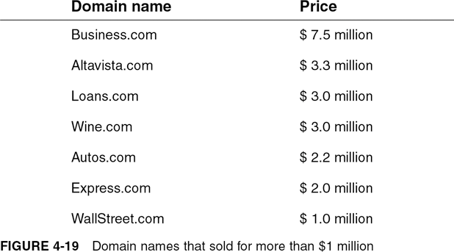
Domain Names that Sold for More than $1 Million
Electronic Commerce, Sixth Edition

Slide 41
URL Brokers and Registrars
URL brokers
  Sell, lease, or auction domain names
ICANN
  Maintains a list of accredited registrars
Domain name parking
  Permits the purchaser of a domain name to maintain a simple Web site so that the domain name remains in use
Electronic Commerce, Sixth Edition

Slide 42
Summary
Four Ps of marketing
  Product, price, promotion, and place
Market segmentation
  Using geographic, demographic, and psychographic information can work well on the Web
Types of online ads
  Pop-ups, pop-behinds, and interstitials
Electronic Commerce, Sixth Edition

Slide 43
Summary (continued)
Technology-enabled customer relationship management can provide better returns for Web businesses
Firms on the Web can use rational branding instead of emotional branding techniques
Critical for many businesses is successful search engine positioning and domain name selection
Electronic Commerce, Sixth Edition

